Slide 1


Air Quality Prediction Over Ahmedabad Using Machine Learning
Yash Dahima
AU2129002
CSE523 - Machine Learning
End Sem Project Presentation

Slide 2
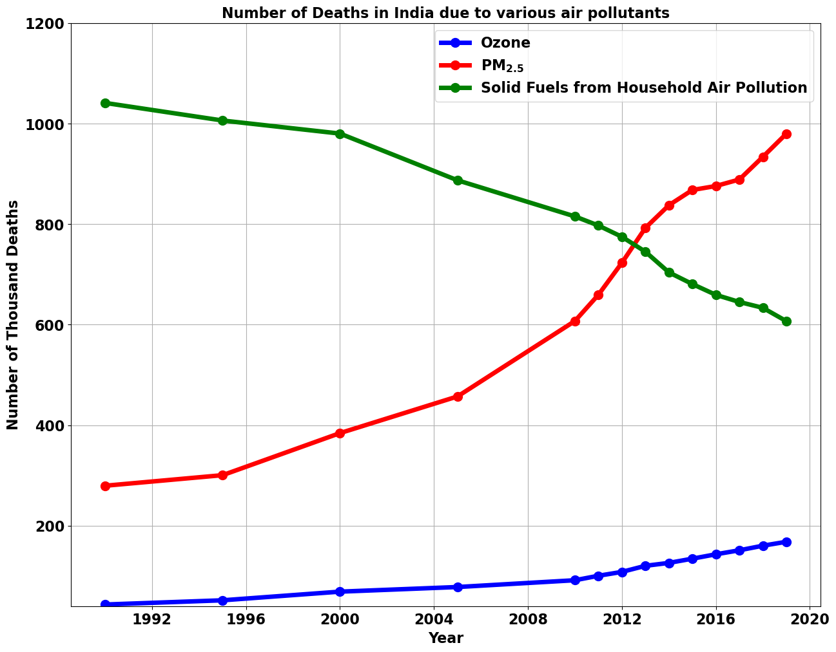
INTRODUCTION
WHO – ‘‘Clean air is considered to be a basic requirement of human health and well-being. However, air pollution continues to pose a significant threat to health worldwide.’’
Air Pollutants – CO, CO₂, Particulate Matter (PM), NO₂, SO₂, etc.
The airborne solid particles having size less than 2.5 µm are called PM_{2.5} pollutants.
https://www.stateofglobalair.org/data/#/air/plot
Notes:
Source of the image, why choosing PM2.5 only?

Slide 3
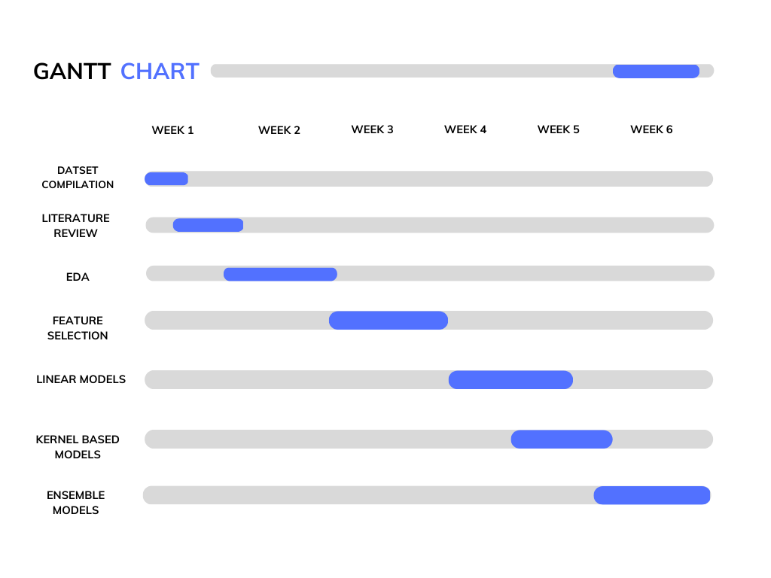
Gantt Chart
Notes:
More details about the dataset, satellite, frequency of the data

Slide 4
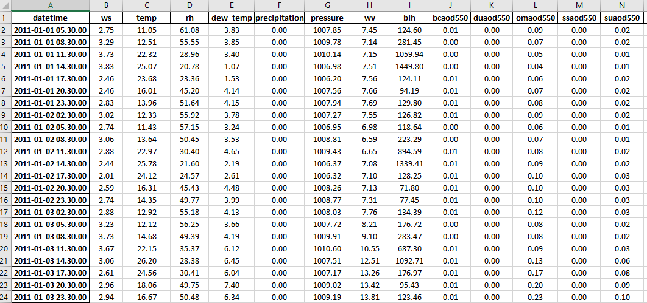
DATASET
Study Region: Ahmedabad & Study Period: 2011-2019, Frequency = 3 hours
ROWS = 26,296 ; COLUMNS = 18
https://ads.atmosphere.copernicus.eu/cdsapp#!/dataset/cams-global-reanalysis-eac4?tab=form
Notes:
More details about the dataset, satellite, frequency of the data

Slide 5
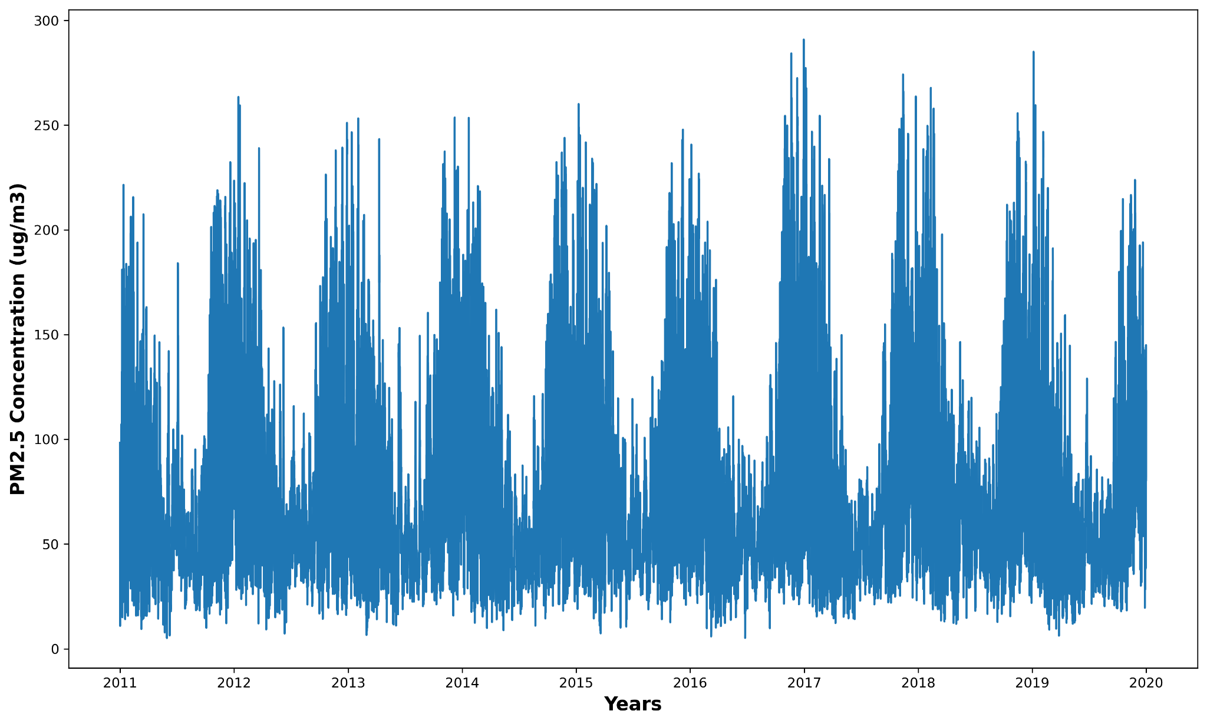
EDA

Slide 6
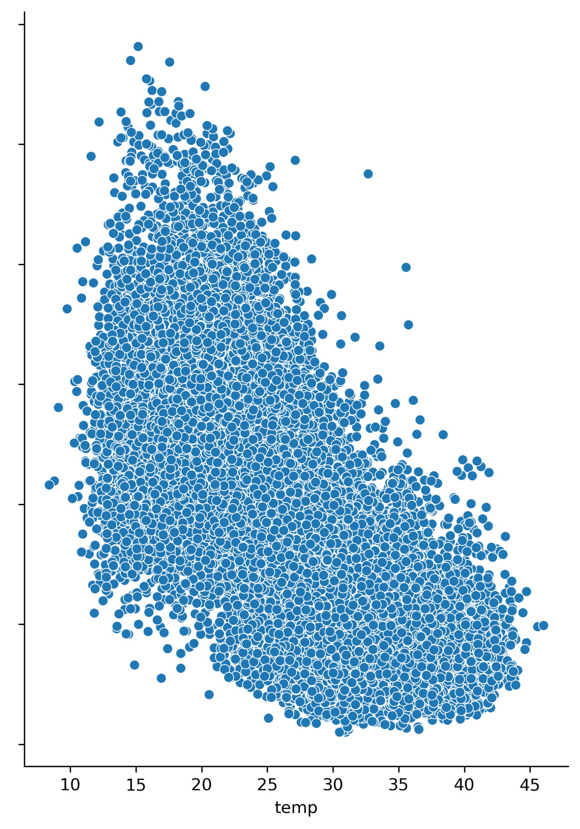
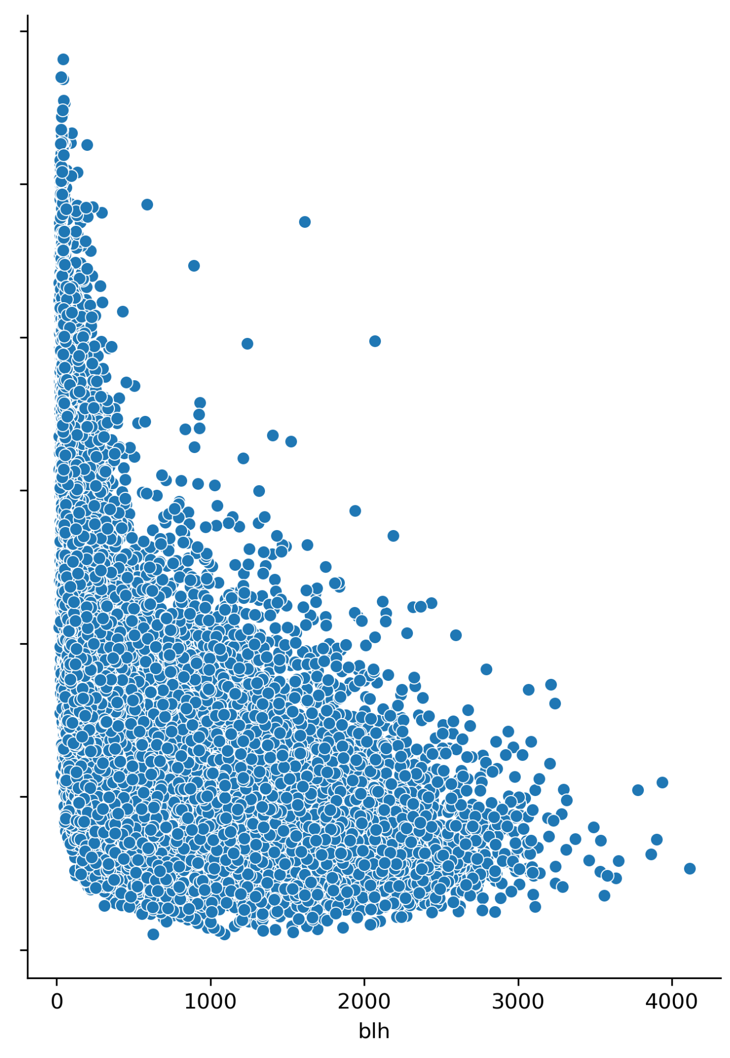
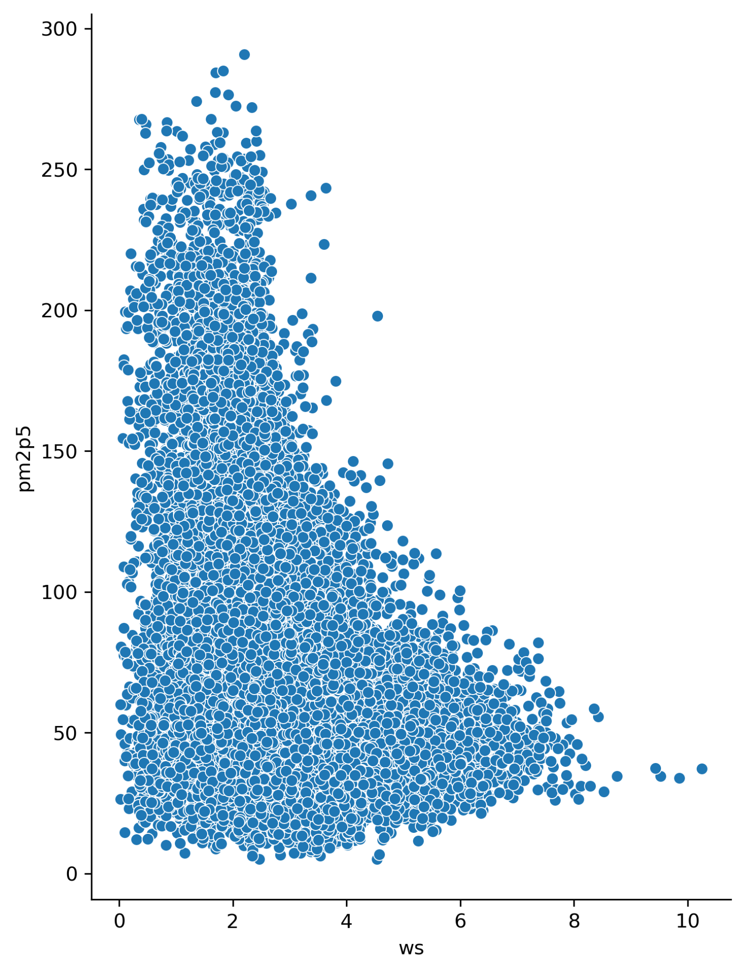
EDA

Slide 7
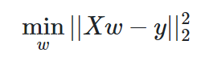
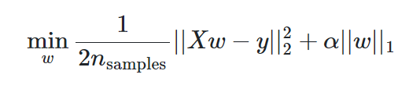
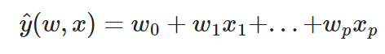
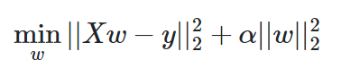
Models
Ordinary Least Squares
Linear Models
Lasso
Ridge
https://scikit-learn.org/stable/modules/linear_model.html

Slide 8
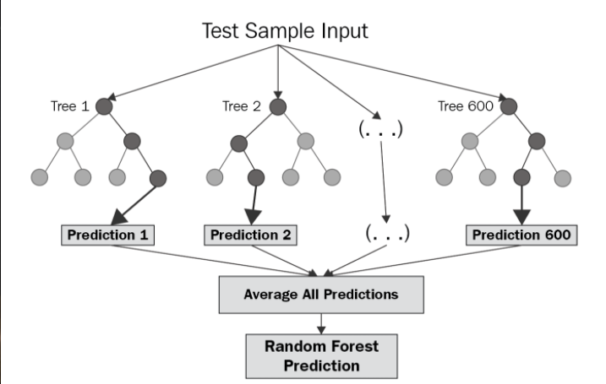
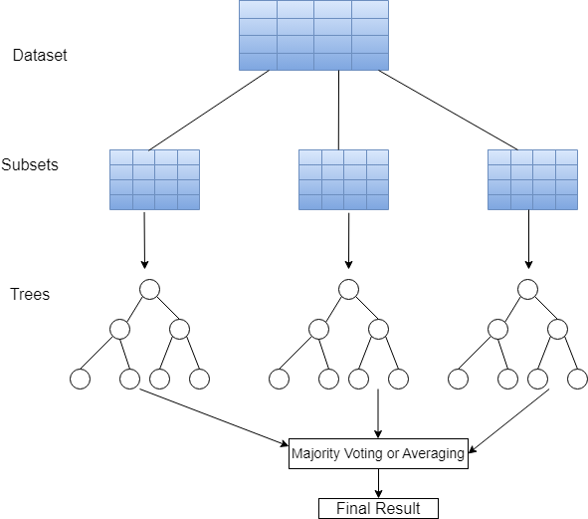
Models
Random Forest
Extra Trees (Extremely Randomized Trees)
https://www.baeldung.com/cs/random-forest-vs-extremely-randomized-trees
https://levelup.gitconnected.com/random-forest-regression-209c0f354c84

Slide 9
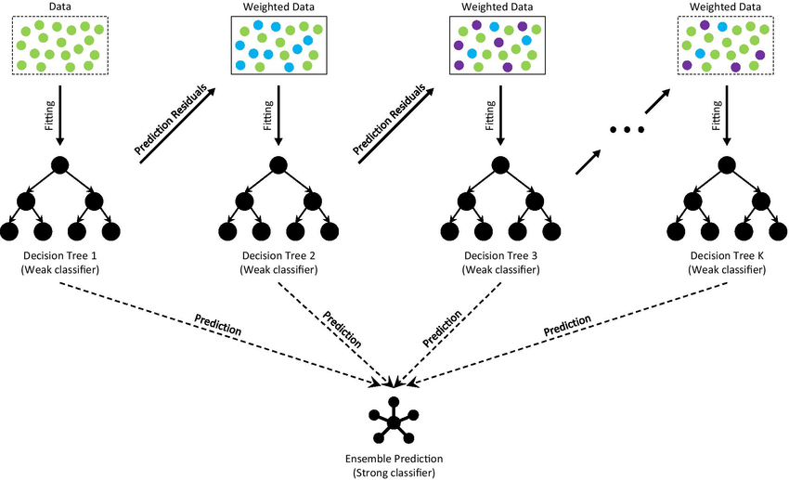
Models
Gradient Boosted Regression Trees
https://www.researchgate.net/publication/356698772_Ensemble_learning_for_the_early_prediction_of_neonatal_jaundice_with_genetic_features

Slide 10
Model Evaluation Metrics
Models | RMSE | MAE | MAPE (%) | R²
Linear (OLS) | 28.33 | 21.69 | 36.03 | 0.56
Ridge | 28.32 | 21.68 | 36.00 | 0.56
Lasso | 28.34 | 21.70 | 36.06 | 0.55
Gaussian Process | 40.50 | 32.40 | 44.50 | 0.1
Kernel Ridge | 53.90 | 40.40 | 47.40 | -0.2
Extra Trees | 19.90 | 15.09 | 25.73 | 0.78
Random Forest | 18.38 | 13.95 | 23.22 | 0.814
Gradient Boosting | 18.20 | 13.63 | 22.19 | 0.818

Slide 11
REFERENCES
[1] Kumar, K., Pande, B.P. Air pollution prediction with machine learning: a case study of Indian cities. Int. J. Environ. Sci. Technol. (2022). https://doi.org/10.1007/s13762-022-04241-5
[2] Doreswamy HKS, Yogesh KM, Gad I (2020) Forecasting Air pollution particulate matter (PM2.5) using machine learning regression models. Procedia Comput Sci 171:2057–2066. https:// doi. org/ 10. 1016/j. procs. 2020. 04. 221
[3] Madhuri VM, Samyama GGH, Kamalapurkar S (2020) Air pollution prediction using machine learning supervised learning approach. Int J Sci Technol Res 9(4):118–123

